Slide 1
Darwin or Design? (A Personal Journey)
Alastair Noble
Peterborough
2019

Slide 2
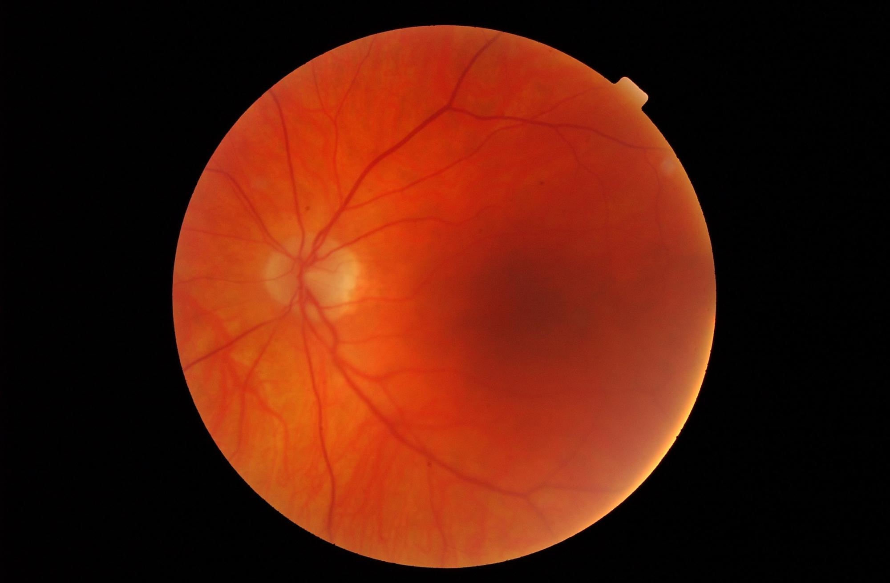

Slide 3
The Biggest Question
Why does anything exist?

Slide 4
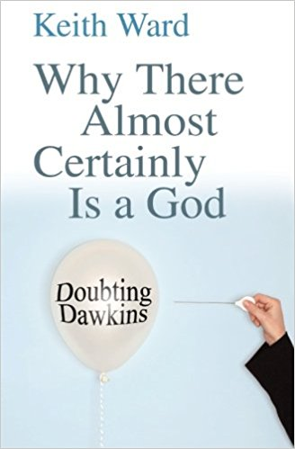
‘If anything exists, then God almost certainly exists’

Slide 5
Other big questions!
Where did the Universe come from?
How did life arise?
What is the origin of our consciousness?

Slide 6
How did Life start?
'We know how simple life evolved into our present biosphere. But we don't know how the first life was generated from a "soup" of chemicals. It might have involved a fluke so rare that it happened only once in the entire galaxy - like shuffling a whole pack of cards into a perfect order. On the other hand, this crucial transition might have been almost inevitable given the "right" environment.'
Lord Rees
The Astronomer Royal

Slide 7
Three Worlds
The Cosmos
The Cell
The Atom

Slide 8
1 Information is the Key to Biology

Slide 9
The Genetic code
carries Information

Slide 10
DNA
‘The machine code of the genes is uncannily computer-like’ – Prof Richard Dawkins
DNA is like a computer programme but far, far more advanced than any software ever created’ – Bill Gates

Slide 11
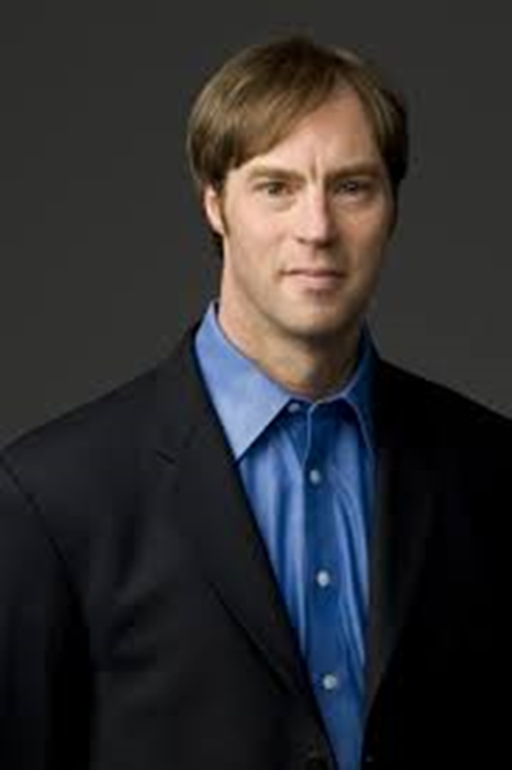
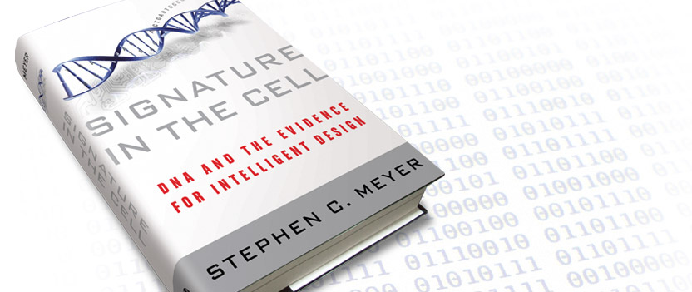
How did the information in DNA arise?

Slide 12
Inference to the best explanation
Intelligent mind is the only known source of specified, functional information – like newsprint or computer software

Slide 13
‘Information is the hallmark of mind. And purely from the evidence of genetics and biology, we can infer the existence of a mind that’s far greater than our own — a conscious, purposeful, rational, intelligent designer who’s amazingly creative. There’s no getting around it.’
Stephen Meyer PhD

Slide 14
26th June 2000
‘Today we are learning the language in which God created life ’ -
Bill Clinton
&
Francis Collins

Slide 15
What is Intelligent Design?
‘Intelligent Design holds that certain features of the universe and of living things are best explained by an intelligent cause, not an undirected process such as natural selection’

Slide 16
‘On the face of it, the universe does look as if it has been designed by an intelligent creator expressly for the purpose of spawning sentient beings.’
p3
‘..I concede that the universe at least appears to be designed with a high level of ingenuity.’
p302

Slide 17
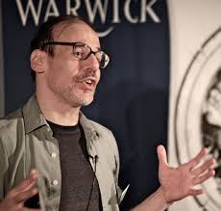
… from cosmology to biology, it is becoming increasingly clear that science’s failure to explain matters at the most fundamental level is at least in part due to an institutional prohibition on intelligent design as one of the explanatory options.
Prof Steve Fuller
Auguste Comte Chair in Social Epistemology Department of Sociology, University of Warwick,
in Theistic Evolution, Crossway 2018, p28

Slide 18
I am a scientist and I think like one. That is one of the main reasons why I am not an atheist
Donald Bruce PhD
..I am not an atheist ..(because my ) .. firm belief (is) that the natural world points very clearly to the existence of an all-powerful and all-wise Creator
Alistair Donald PhD

Slide 19
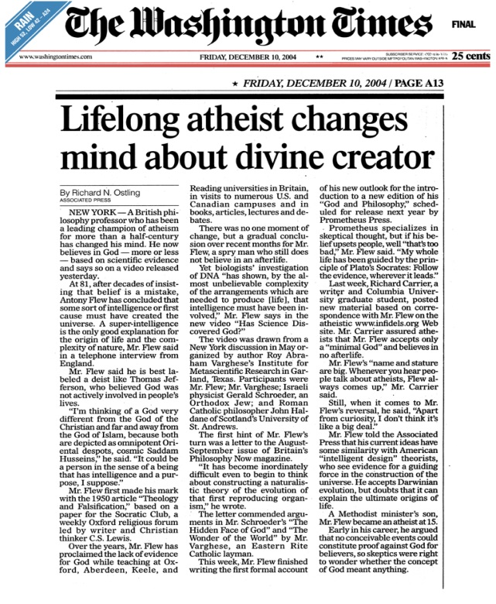
The God Delusion by the atheist writer Richard Dawkins, is remarkable in the first place for having achieved some sort of record by selling over a million copies. But what is much more remarkable than that economic achievement is that the contents – or rather lack of contents – of this book show Dawkins himself to have become what he and his fellow secularists typically believe to be an impossibility: namely, a secularist bigot. (Helpfully, my copy of The Oxford Dictionary defines a bigot as ‘an obstinate or intolerant adherent of a point of view’).
Antony Flew

Slide 20
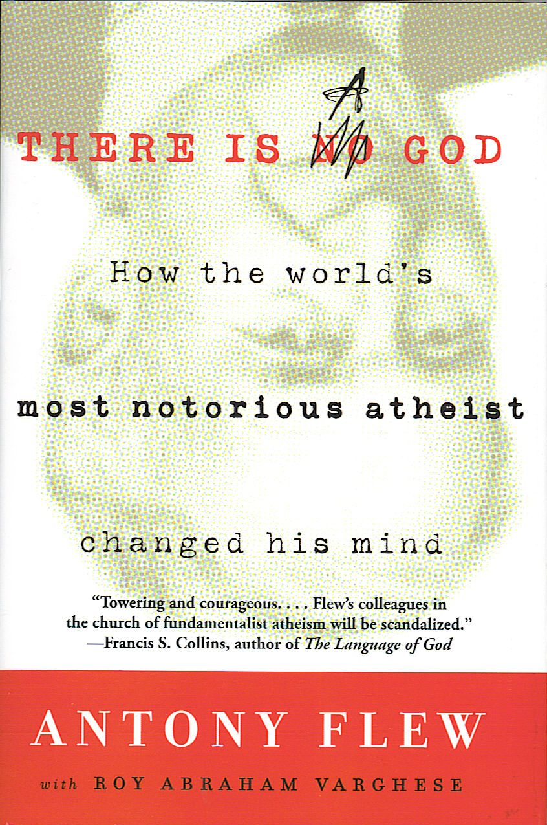
Three
mind-changing considerations
nature exists
nature obeys laws
life is intelligently organised

Slide 21
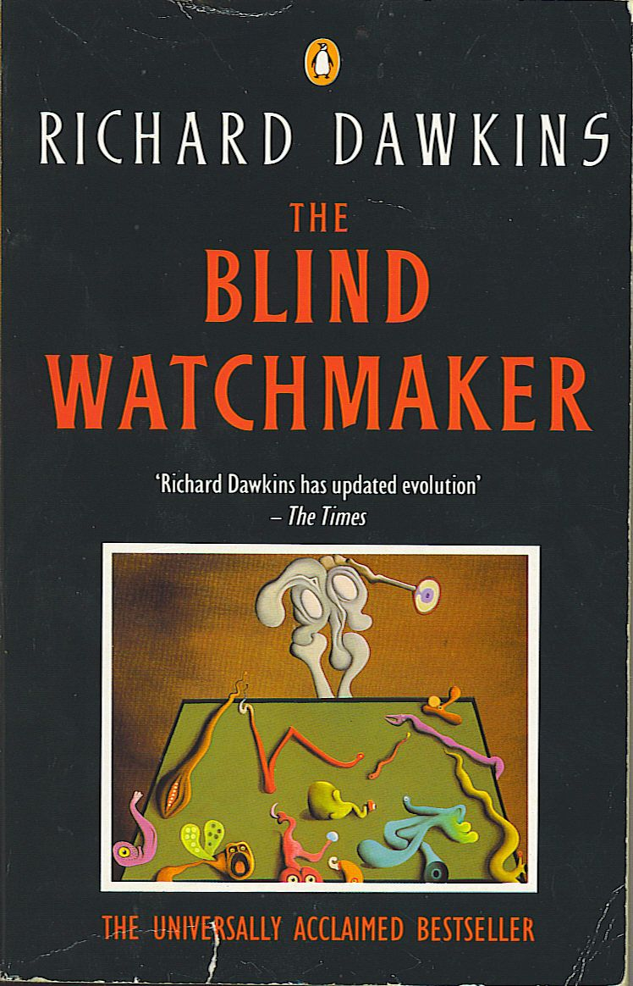
‘Darwinism makes atheism intellectually satisfying’
More I want to persuade the reader, not just that the Darwinian world-view happens to be true, but that it is the only known theory that could, in principle, solve the mystery of our existence. That makes it a doubly satisfying theory. A good case can be made that Darwinism is true, not just on this planet but all over the universe wherever life is found.

Slide 22
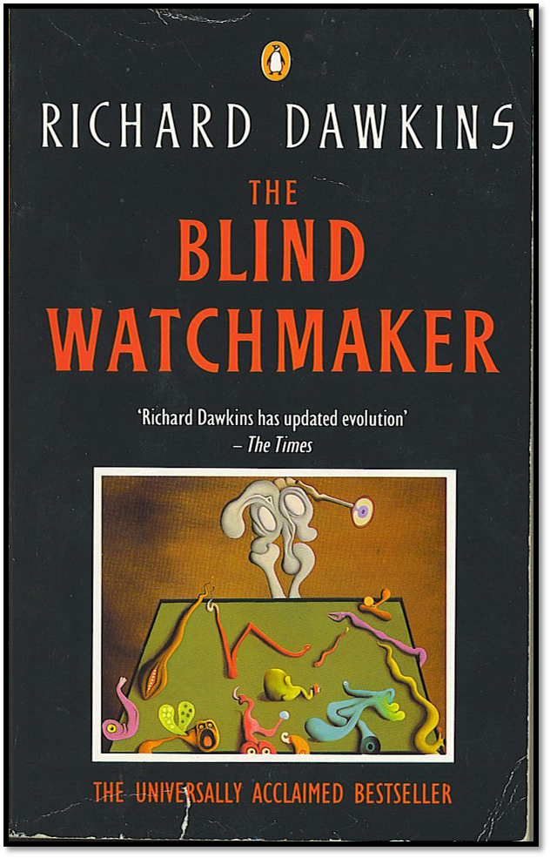
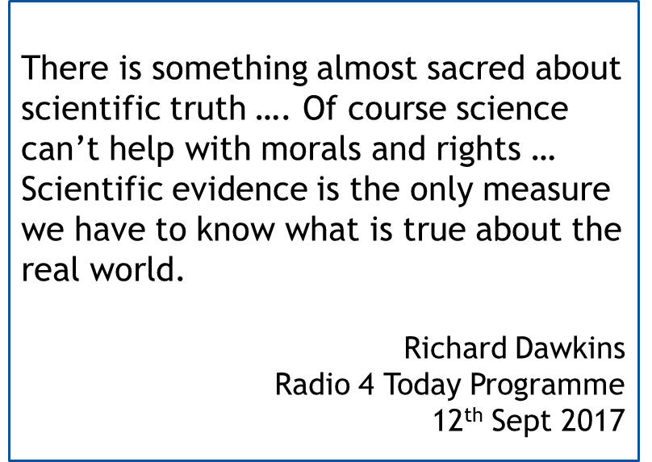

Slide 23
‘We are all accidents’
‘There is no reason to suppose that science cannot deal with every aspect of existence’
Peter Atkins, Prof of Chemistry, Oxford
‘That, in a nutshell, is the essence of scientism’
John Lennox, Prof of Mathematics, Oxford

Slide 24
2 There’s something wrong in the Domain of Darwin

Slide 25
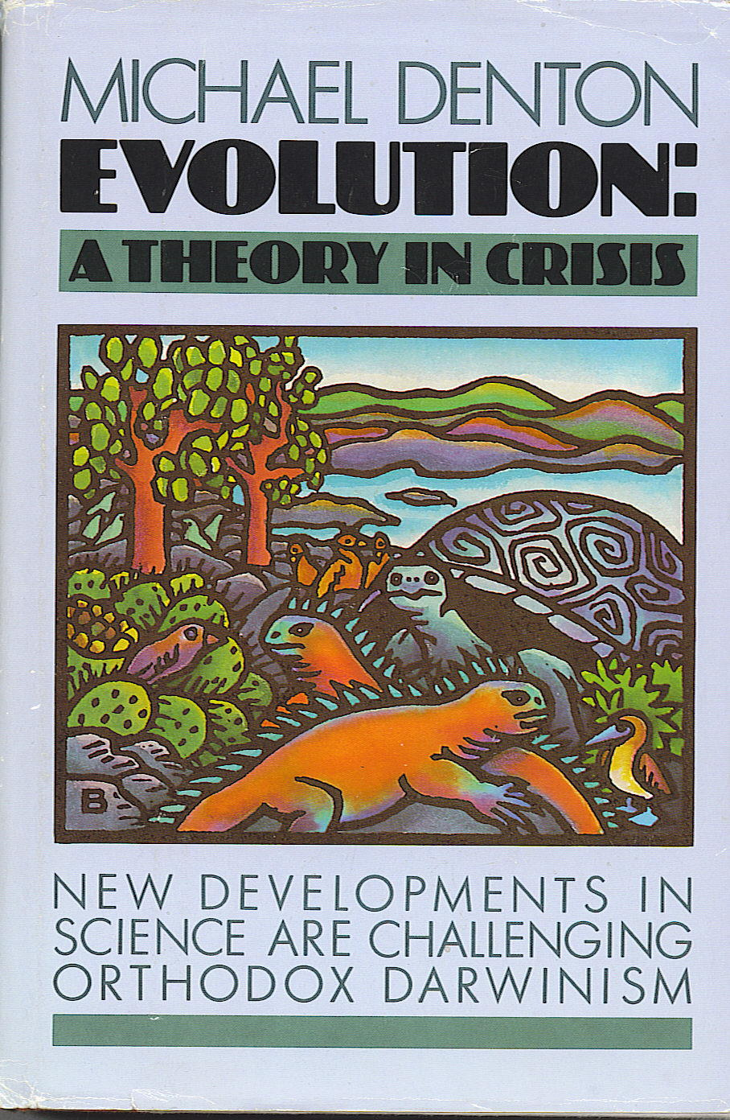
‘It is the sheer universality of perfection, the fact that everywhere we look, to whatever depth we look, we find an elegance and ingenuity of an absolutely transcending quality, which so mitigates against the idea of chance.
1986

Slide 26
‘The Darwinian theory of evolution is no more or less than the great cosmogenic myth of the twentieth century’
Michael Denton

Slide 27
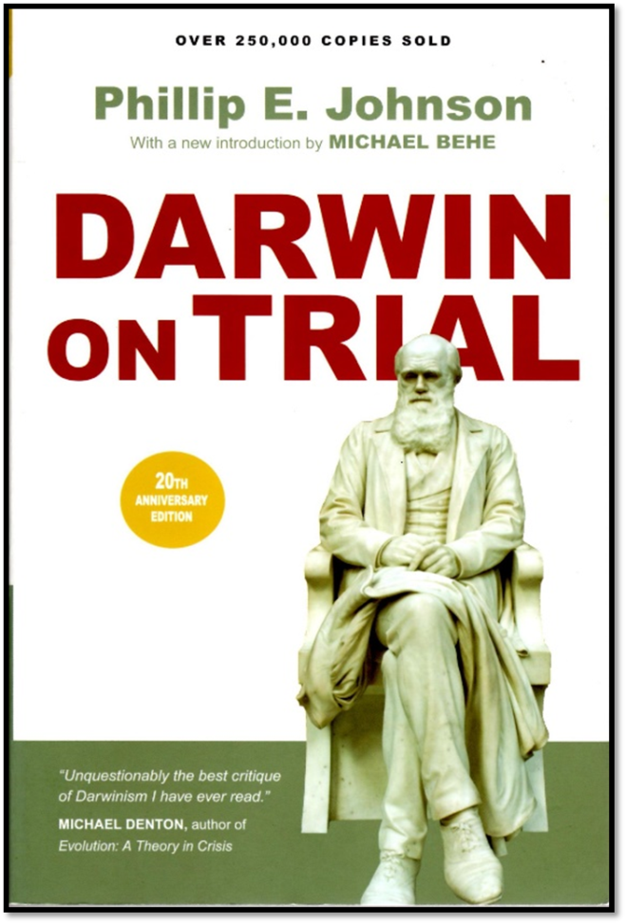
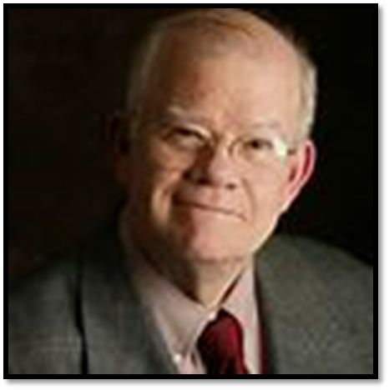
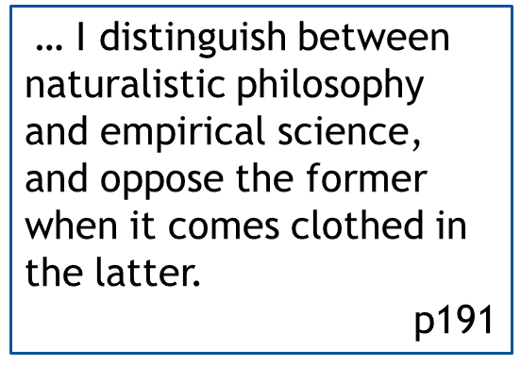
Philip Johnston is a lawyer whose books on Darwinism have challenged the prevailing consensus. He is a graduate of Harvard and Chicago Law Schools, was Clerk to the US Senate, and Professor of Law at Berkeley, California

Slide 28
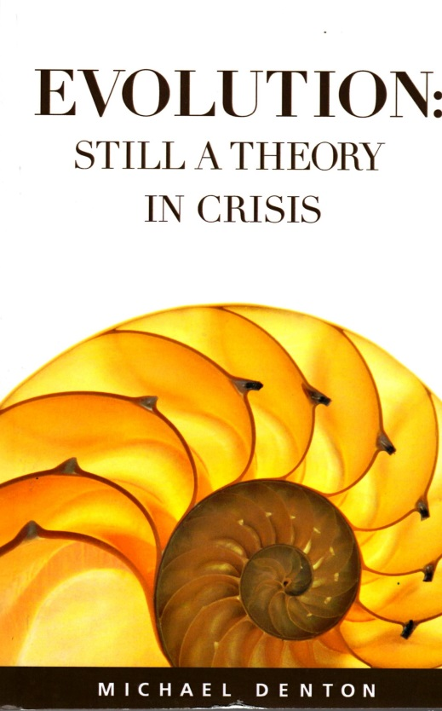
Books of the Year 2016
A N Wilson, well-known writer and newspaper columnist, chooses:

Slide 29
‘This takes us up to date with the dazzling developments of life sciences over the past 30 years. Denton is a sceptic about Darwin’s theory of evolution on purely scientific grounds. It is hard to see how anyone reading this book could not be persuaded.’

Slide 30
‘Palaeontology provides abundant evidence of evolution within species, but none of one species morphing into another. Denton is fascinatingly clear in his exposition of the science of genetics, and how it destroys the Darwinian position. A truly great book.’

Slide 31
‘ … Darwin’s theory of natural selection is fatally flawed.’
pxiv

Slide 32
‘ … the continued insistence on the random nature of genetic change by evolutionists should be surprising …’

Slide 33
The existence of consciousness is both one of the most familiar and one of the most astounding things about the world. …
And if physical science, whatever it may have to say about the origin of life, leaves us necessarily in the dark about consciousness, that shows that it cannot provide the basic form of intelligibility for this world.

Slide 34
(Neo-Darwinism):
‘a heroic triumph of ideological theory over common sense’ (p128)

Slide 35
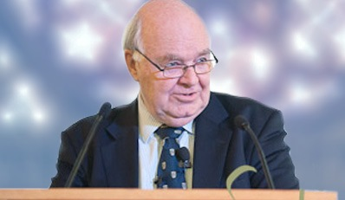
Prof John Lennox Oxford
‘Either human intelligence ultimately owes its origin to mindless matter; or there is a Creator. It is strange that some people claim that it is their intelligence that leads them to prefer the first to the second.’

Slide 36
The Royal Society 7-9th November 2016 London
Developments in evolutionary biology and adjacent fields have produced calls for revision of the standard theory of evolution, although the issues involved remain hotly contested. This meeting will present these developments and arguments in a form that will encourage cross-disciplinary discussion and, in particular, involve the humanities and social sciences in order to provide further analytical perspectives and explore the social and philosophical implications.
New trends in evolutionary biology: biological, philosophical and social science perspectives

Slide 37
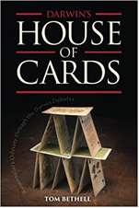
(Sir Julian) Huxley … declared that “Darwinism removed the whole idea of God as creator of organisms from the sphere of rational discussion”
Evolution after Darwin, Vol 3,44
It’s also time to point out that that Darwinian evolution never did have much in the way of evidence to support it. Today, following Julian Huxley’s lead, it is often embraced more for the support it gives to atheistic philosophy than for its science. The scientific evidence for evolution is not only weaker than is generally supposed, but as new discoveries have been made since 1959, the reasons for accepting the theory have diminished rather than increased.
House of Cards, Bethell p45

Slide 38
3 Design all the way down !

Slide 39
Intuition
Intelligence
Intelligibility
Intentionality
Improbability
Intricacy
Information
Pointers
to Intelligent Design

Slide 40
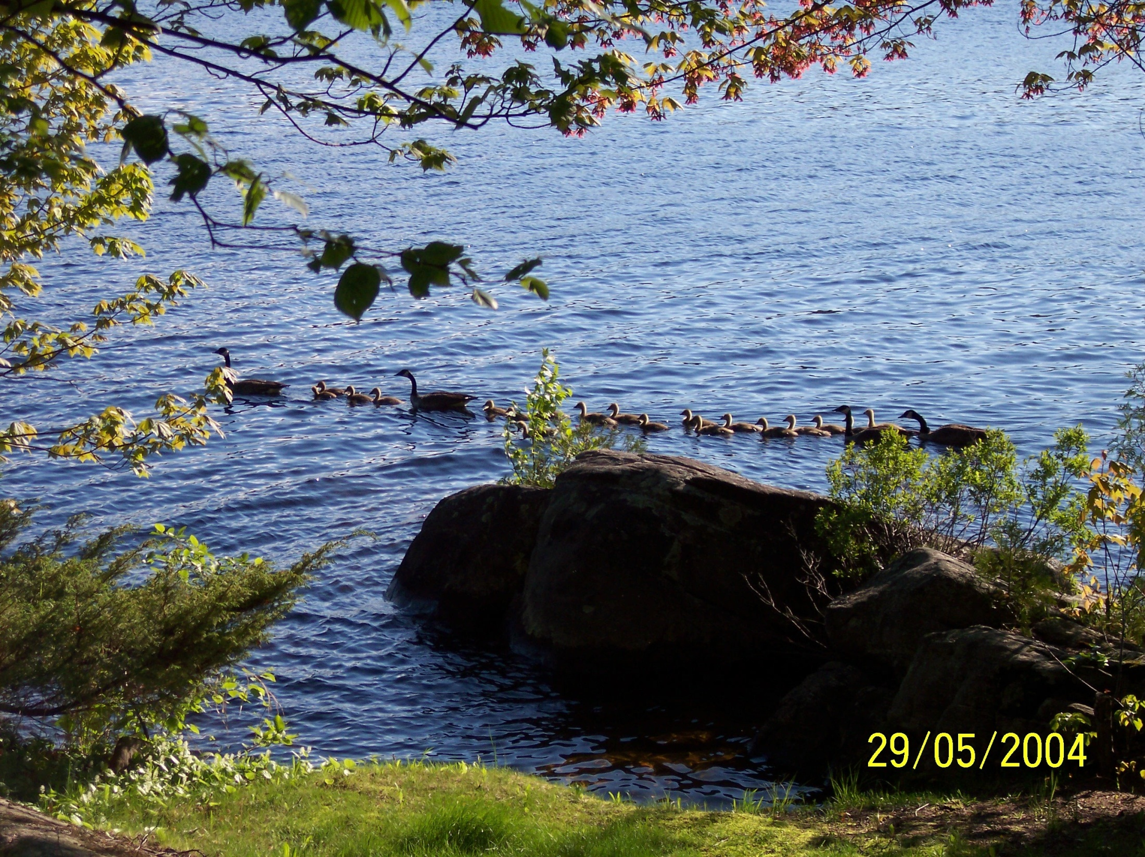
Intuition – Nature suggests design

Slide 41
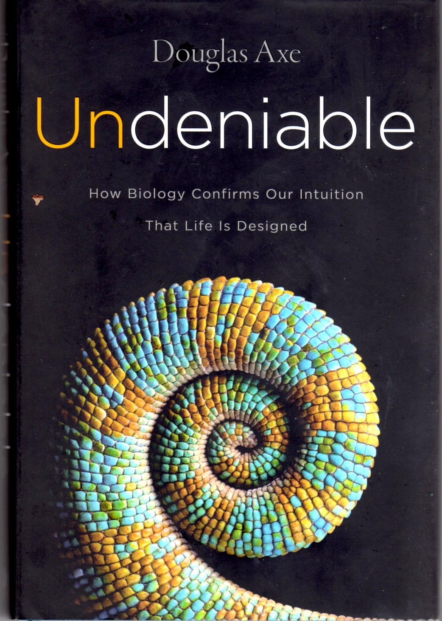
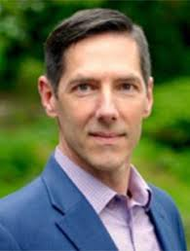
Axe’s intention is to give the ordinary reader the confidence to ‘affirm what once seemed obvious to all of us – that living creatures, from single-celled cyano-bacteria to orca whales and human beings, are brilliantly conceived, utterly beyond the reach of chance’.

Slide 42
The existence of consciousness is both one of the most familiar and one of the most astounding things about the world. …
And if physical science, whatever it may have to say about the origin of life, leaves us necessarily in the dark about consciousness, that shows that it cannot provide the basic form of intelligibility for this world.
(Neo-Darwinism):
‘a heroic triumph of ideological theory over common sense’ (p128)
2 Intelligence in mind and brain

Slide 43
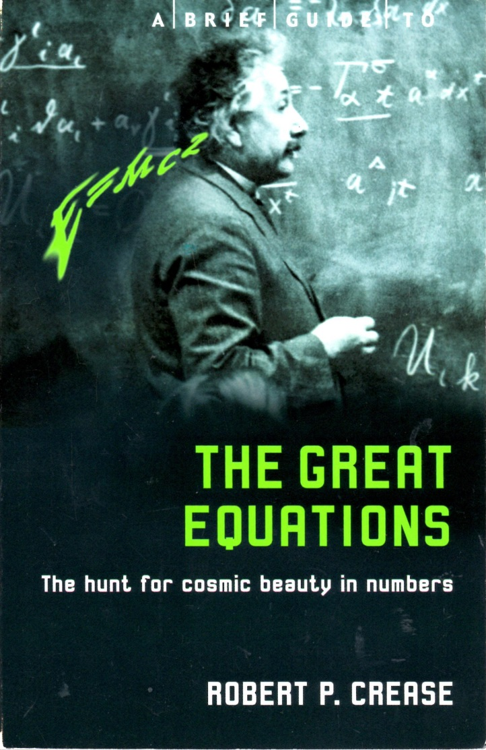
Why should the universe follow set laws and why should we be able to perceive them?
3 Intelligibility of the Universe

Slide 44
Coincidence that sun and moon seem same size?
The sun and moon appear the same size in Earth’s sky because the sun’s diameter is about 400 times greater – but the sun is also about 400 times farther away.
4 Intentionality in cosmic ‘fine-tuning’

Slide 45
When liquids cool they become more dense, the cooler liquid sinks and then freezes at the bottom.
The ‘anomalous expansion of water’ begins at 4⁰C so that the cooler water then rises and ice forms on the surface.

Slide 46
A finely-tuned universe?
A common sense interpretation of the data suggests that a super-intellect has monkeyed with physics, as well as with chemistry and biology.
Sir Fred Hoyle, cosmologist

Slide 47
Neither Darwin, Dawkins nor any other biologist has ever calculated the probability of a random search finding in the finite time available the sorts of complex systems which are so ubiquitous in nature. Even today we have no way of rigorously estimating the probability or degree of isolation of even one functional protein. It is surely a little premature to claim that random processes could have assembled mosquitoes and elephants when we still have to determine the actual probability of the discovery by chance of one single functional protein molecule!
Michael Denton, Evolution: A theory in Crisis, Adler and Adler, 1986, p324
Improbability of spontaneously generated macromolecules

Slide 48
The Bacterial Flagellum
6 Intricacy and irreducible
complexity of molecular machines

Slide 49
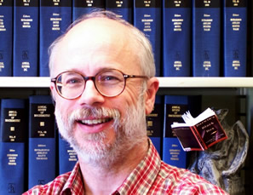
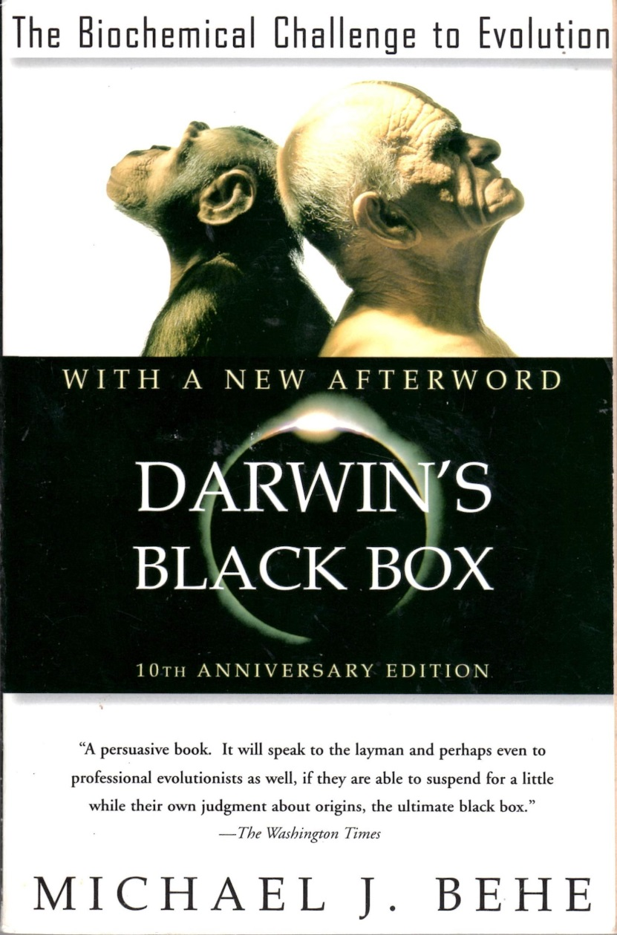
Michael Behe
See the new film ‘Revolutionary’
available on line
https://revolutionarybehe.com/

Slide 50
7 Information in the genetic code

Slide 51
4 The Biggest Questions

Slide 52
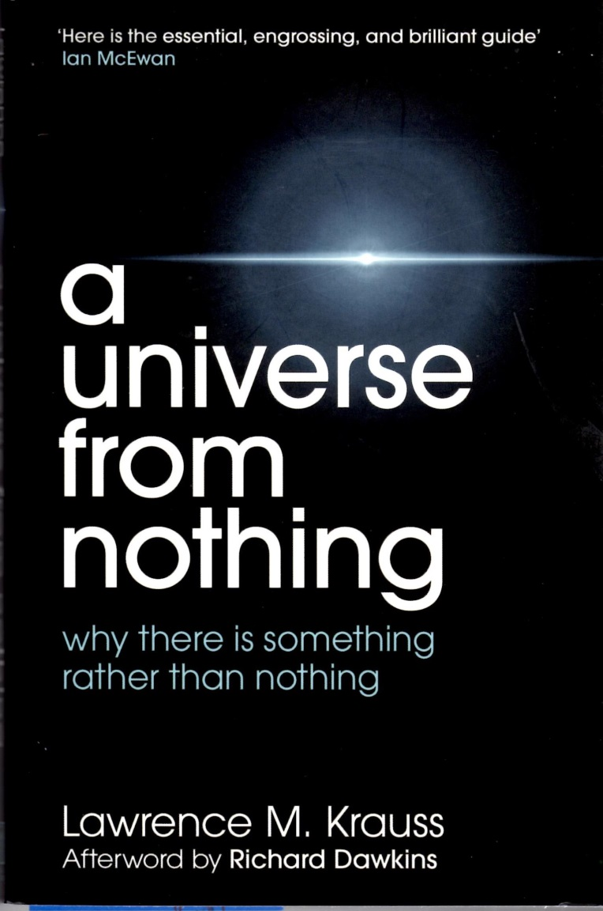
Where did the universe come from?
A fascinating antidote to outmoded philosophical and religious thinking … a provocative game-changing entry into the debate about the existence of God and everything that exists. .. Forget Jesus … the stars died so that you could be born.
Book cover
..all the signs suggest that (something from nothing) is how our universe could have arisen.
I stress the word could here, because we may never have enough empirical information to resolve this question unambiguously’
P xiii

Slide 53
‘An infinite number of universes is more plausible than God’
Sean Carroll
Caltech

Slide 54
Prof Stephen Hawking
‘Because there is a law of gravity, the universe can and will create itself out of nothing’

Slide 55
Prof John Lennox Oxford
What all this goes to show is that nonsense remains nonsense, even when talked by world-famous scientists.”
God and Stephen Hawking, p32

Slide 56
5 Darwinism is ultimately Philosophy, not Science

Slide 57
‘Even if all the data point to an intelligent designer, such an hypothesis is excluded from science because it is not naturalistic’
Scott C Todd in a letter to Nature, Sept 30, 1999
Not the facts
but the philosophy !
P Johnson

Slide 58
Our willingness to accept scientific claims that are against common sense is the key to an understanding of the real struggle between science and the supernatural. We take the side of science in spite of the patent absurdity of some of its constructs, in spite of its failure to fulfil many of its extravagant promises of health and life, in spite of the tolerance of the scientific community for unsubstantiated just-so stories, because we have a prior commitment, a commitment to materialism.
Richard Lewontin
Professor of Biology, Harvard

Slide 59
‘Our concern … is whether a secular indoctrination process is at work in British and European society, programming people against religious belief and, if so, whether education is an accomplice in this.’

Slide 60
Though these bodies may, indeed, persevere in their orbits by the mere laws of gravity, yet they could by no means have, at first, derived the regular position of the orbits themselves from those laws…
(Thus) this most beautiful system of the sun, planets and comets, could only proceed from the counsel and dominion of an intelligent and powerful Being…
This Being governs all things..
Intelligibility and Contingency
Sir Isaac Newton -
the greatest scientist?

Slide 61
Cavendish Laboratory, Cambridge
‘Great are the works of the Lord, sought out by all who take pleasure therein’
The inscription summarised Maxwell’s inspiration for scientific study: the thought that the works of nature reflect the work of a designing mind. In this belief he had been joined by many of the leading scientists of Western civilisation for over four hundred years – Copernicus, Kepler, Ray, Linnaeus, Curvier, Agassiz, Boyle, Newton, Kelvin, Faraday, Rutherford – on and on the list could go’
Stephen Meyer

Slide 62
St Paul on Design
…since what may be known about God … is plain, because God has made it plain …
For since the creation of the world God's invisible qualities - his eternal power and divine nature - have been clearly seen, being understood from what has been made, so that people are without excuse.
Romans 1 v19-20
.

Slide 63
In the beginning was the Word
( logos = mind, rationality, information),
and the Word was with God,
and the Word was God.
The Word became flesh and made his dwelling among us…
John 1v1 and 14

Slide 64
www.c4id.org.uk
Alastair.n@c4id.org.uk

